Slide 1
ATAI
Advanced Technique of Artificial Intelligence
ATAI
ChongqingUniversity _{AdvancedTechniqueof}
of Technology Artificial Intelligence
Chongqing University of Technology
Chongqing University ^{ATAI}
_{of Technology} Advanced Techniqueof
Artificial Intelligence
Chongqing University of Technology
Chongqing University of Technology
Intra and Inter-modality Incongruity Modeling and Adversarial Contrastive Learning for Multimodal Fake News Detection
code:none
Reported by Shu Ming Jiang
1

Slide 2
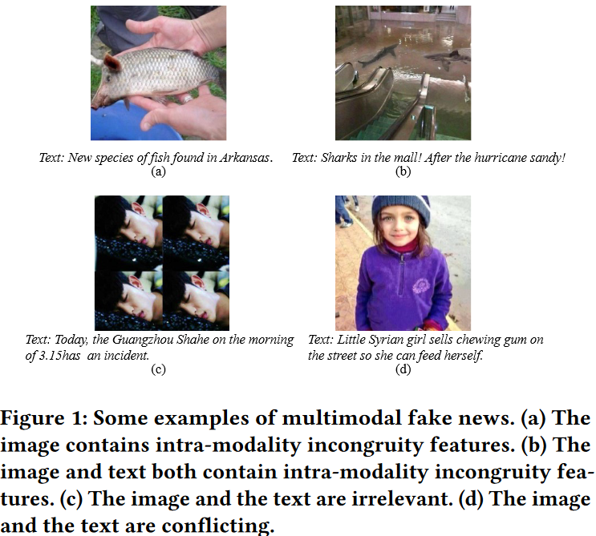
ATAI
Advanced Technique of
Artificial Intelligence
ATAI
ChongqingUniversity _{AdvancedTechniqueof}
of Technology Artificial Intelligence
Chongqing University of Technology
Motivation
1)Neglect of intra and inter-modality incongruity features.Prior studies primarily concentrate on common semantics across various modalities, neglecting intra and inter-modality incongruent semantic features.
2)Lack of robustness to adversarial samples. In some cases, just introducing a simple adversarial perturbation may lead to misclassification of labels, which presents a significant risk to the fake news detection system .

Slide 3
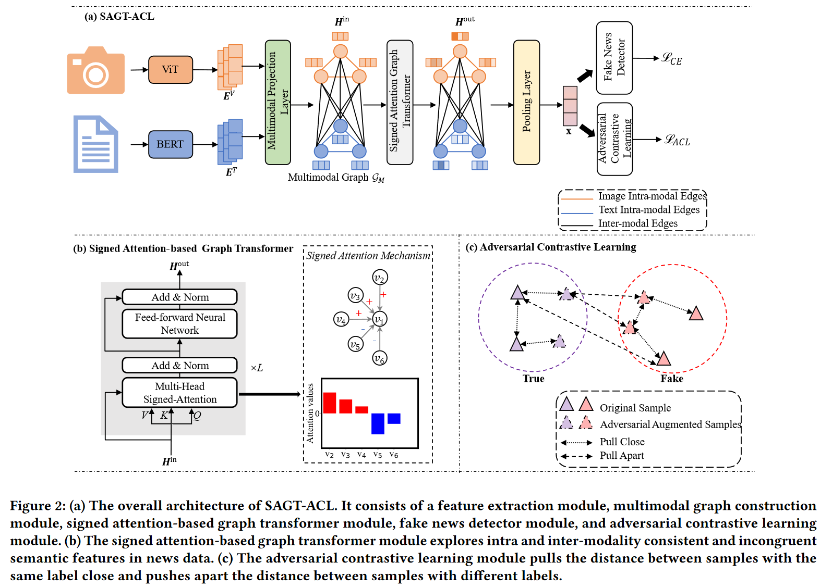
ATAI
Advanced Technique of
Artificial Intelligence
ATAI
ChongqingUniversity _{AdvancedTechniqueof}
of Technology Artificial Intelligence
Chongqing University of Technology
Overview

Slide 4
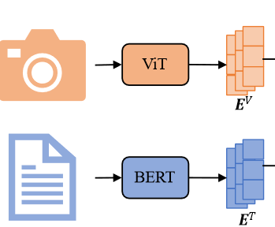
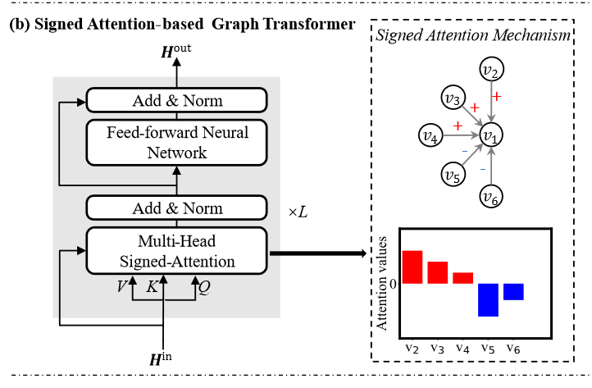
ATAI
Advanced Technique of
Artificial Intelligence
ATAI
ChongqingUniversity _{AdvancedTechniqueof}
of Technology Artificial Intelligence
Chongqing University of Technology
Method

Slide 5
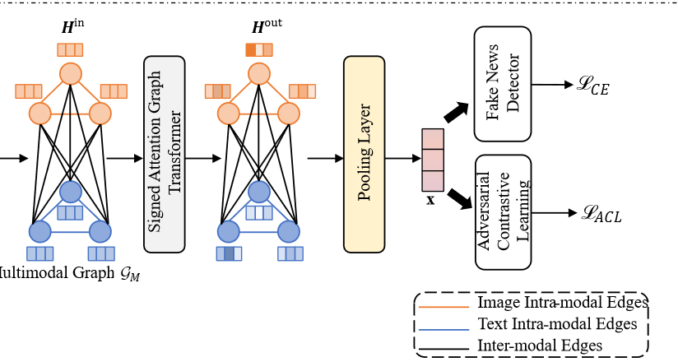
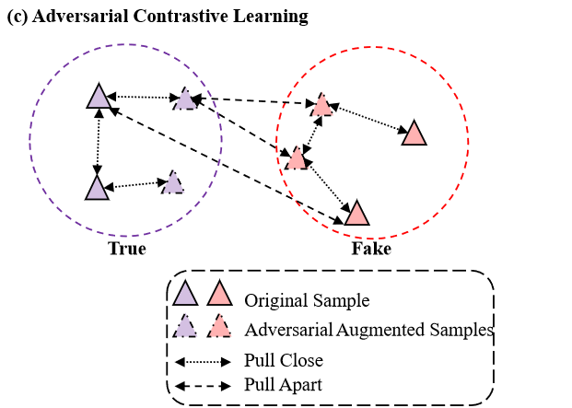
ATAI
Advanced Technique of
Artificial Intelligence
ATAI
ChongqingUniversity _{AdvancedTechniqueof}
of Technology Artificial Intelligence
Chongqing University of Technology
Method

Slide 6
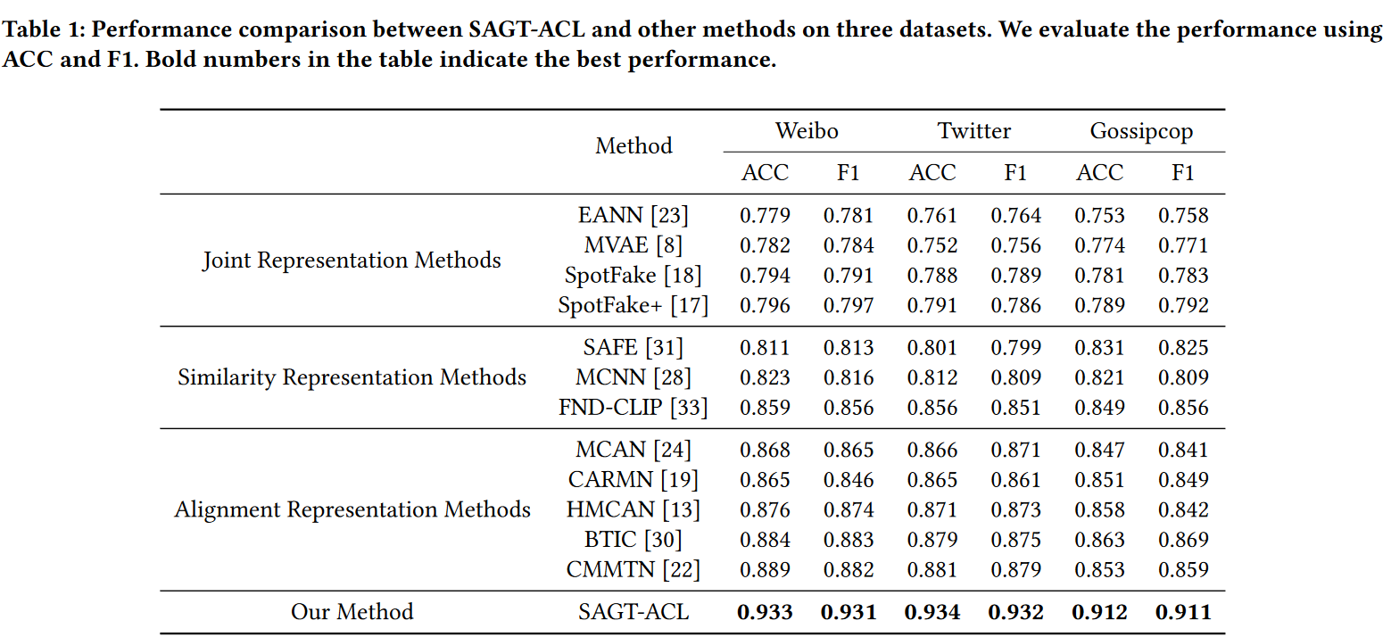
ATAI
Advanced Technique of
Artificial Intelligence
ATAI
ChongqingUniversity _{AdvancedTechniqueof}
of Technology Artificial Intelligence
Chongqing University of Technology
Experiments

Slide 7
ATAI
Advanced Technique of
Artificial Intelligence
ATAI
ChongqingUniversity _{AdvancedTechniqueof}
of Technology Artificial Intelligence
Chongqing University of Technology
Experiments

Slide 8
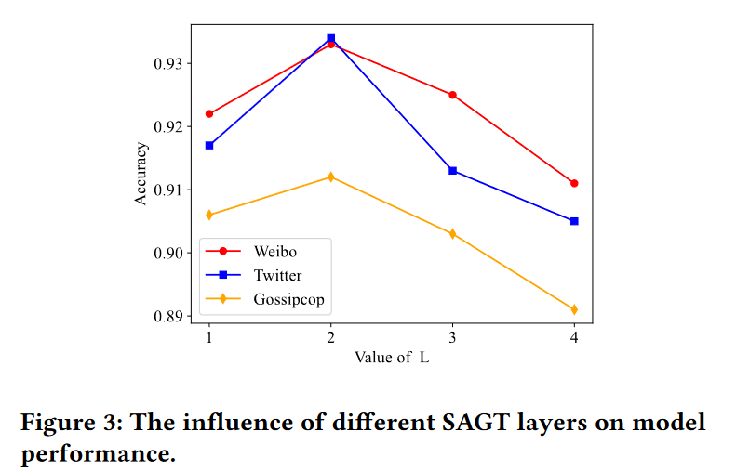
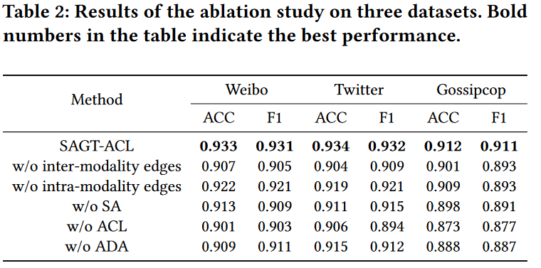
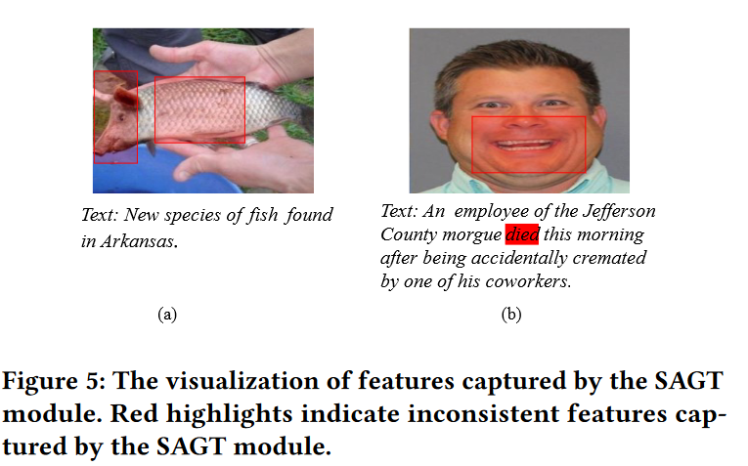
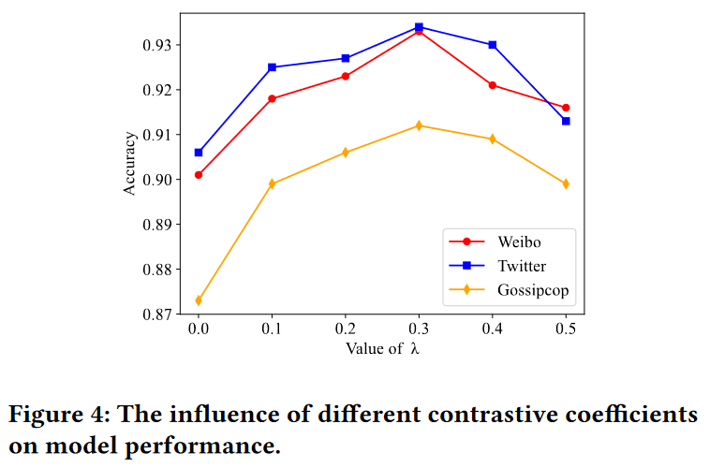
ATAI
Advanced Technique of
Artificial Intelligence
ATAI
ChongqingUniversity _{AdvancedTechniqueof}
of Technology Artificial Intelligence
Chongqing University of Technology
Experiments

